Slide 1
PRODUCTION PLANNING AND CONTROL
Prof. N. S. Surner
SRES, Sanjivani College of Engineering, Kopargaon

Slide 2
Syllabus
Introduction: Types of production systems, Need and functions of PPC, Aggregate production planning.
Capacity Planning, ERP: Modules, Master Production Schedule, MRP and MRP-II.
Forecasting Techniques: Causal and time series models, moving average, exponential smoothing, trend and seasonality (Numerical), Demand Control strategies (MTO, MTA, MTS). Introduction to Supply Chain Management: Basic terminologies.

Slide 3
Types of Production Systems
Production systems are usually classified on the basis of the following:
Type of product,
Type of production line,
Rate of production,
Equipment used etc.
They are broadly classified into three categories:
Job shop production
Batch production
Mass production

Slide 4
Production Planning and Control
Production Planning is a managerial function which is mainly concerned with the following important issues:
What production facilities are required?
How these production facilities should be laid down in the space available for production? and
How they should be used to produce the desired products at the desired rate of production?

Slide 5
PPC Functions
Production control is a mechanism to monitor the execution of the plans. It has several important functions:
Making sure that production operations are started at planned places and planned times.
Observing progress of the operations and recording it properly.
Analyzing the recorded data with the plans and measuring the deviations.
Taking immediate corrective actions to minimize the negative impact of deviations from the plans.
Feeding back the recorded information to the planning section in order to improve future plans.

Slide 6
Better Service to Customers
Fewer Rush Orders
Better Control of Inventory
More Effective Use of Equipment
Reduced Idle Time
Improved Plant Morale
Good public image
Lower capital requirements

Slide 7
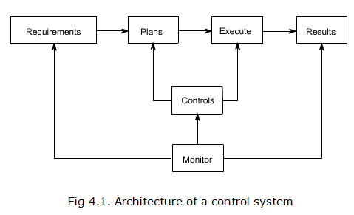

Slide 8
Functions | Issues to be covered
Product Design & Development | Customer needs, market needs, availability of similar product, demand-supply gap, functional aspects, operational aspects, environmental aspects etc.
Demand Forecasting | Quantity, Quality, Demand Pattern.
Capacity Planning | No. of machines, No. of tooling, workers, No.of flow lines, Quantity, Quality and rate of production, demand pattern.
Equipments Selection & Maintenance | No. of machines, type of M/c, Quality aspects, Quantity aspects, rate of production, Cost of equipments, support from the supplier, maintenance policy, storage of spare parts.
Tooling Selection | Compactability between w/c steels, No. of tools, their cost, their material etc, storage policy.
Material Selection & Management | Types, specification, quality aspect, quantity aspect, cost, supplies reputation , lot size, inventory levels, setup cost, mode of transportation etc.
Process Planning | Generation of manufacture instruction, selection of M/c, tools, parameters, sequence etc.
Loading | Division of work load, assignment of tasks, uniform loading, matching between capability & capacity with job requirements.
Routing | Path selection for material movement as per the process plan and loading, minimum material handling and waiting time.
Scheduling | Time based loading, start and finish times, due dates, dispatching rules, re-scheduling.
Expediting | Operation Scheduling and order and progress reporting.

Slide 9
Aggregate Planning
An organization can finalize its business plans on the recommendation of demand forecast.
Once business plans are ready, an organization can do backward working from the final sales unit to raw materials required.
Thus annual and quarterly plans are broken down into labor, raw material, working capital, etc. requirements over a medium-range period (6 months to 18 months).
This process of working out production requirements for a medium range is called aggregate planning.

Slide 10
Following factors are critical before an aggregate planning process can actually start;
A complete information is required about available production facility and raw materials.
A solid demand forecast covering the medium-range period
Financial planning surrounding the production cost which includes raw material, labor, inventory planning, etc.
Organization policy around labor management, quality management, etc.

Slide 11
Importance of Aggregate Planning
Aggregate planning plays an important part in achieving long-term objectives of the organization. Aggregate planning helps in:
Achieving financial goals by reducing overall variable cost and improving the bottom line
Maximum utilization of the available production facility
Provide customer delight by matching demand and reducing wait time for customers
Reduce investment in inventory stocking
Able to meet scheduling goals there by creating a happy and satisfied work force

Slide 12
Capacity Planning
The production system design planning considers input requirements, conversion process and output. After considering the forecast and long-term planning organization should undertake capacity planning.
Capacity is defined as the ability to achieve, store or produce. For an organization, capacity would be the ability of a given system to produce output within the specific time period. In operations, management capacity is referred as an amount of the input resources available to produce relative output over period of time.

Slide 13
Capacity Planning Classification
Long Term Capacity: Long range capacity of an organization is dependent on various other capacities like design capacity, production capacity, sustainable capacity and effective capacity.
Medium Term Capacity: The strategic capacity planning undertaken by organization for 2 to 3 years of a time frame is referred to as medium term capacity planning.
Short Term Capacity: The strategic planning undertaken by organization for a daily weekly or quarterly time frame is referred to as short term capacity planning.

Slide 14
ERP (Enterprise resource planning)
It is the integrated management of core business processes, often in real-time and mediated by software and technology. These business activities can include:
Product planning, purchase
Production planning
manufacturing or service delivery
marketing and sales
materials management
inventory management
Shipping and payment
Finance
ERP is usually referred to as category of business-management software—typically a suite of integrated applications—that an organization can use to collect, store, manage and interpret data from these many business activities.

Slide 15
Advantages of ERP
The fundamental advantage of ERP is that the integration of myriad business processes saves time and expense. Management can make decisions faster and with fewer errors. Data becomes visible across the organization. Tasks that benefit from this integration include.
Sales forecasting, which allows inventory optimization.
Chronological history of every transaction through relevant data compilation in every area of operation.
Order tracking, from acceptance through fulfillment
Revenue tracking, from invoice through cash receipt
Matching purchase orders (what was ordered), inventory receipts (what arrived), and costing (what the vendor invoiced)

Slide 16
Disadvantages of ERP
Customization can be problematic. Compared to the best-of-breed approach, ERP can be seen as meeting an organization’s lowest common denominator needs, forcing the organization to find workarounds to meet unique demands.
Re-engineering business processes to fit the ERP system may damage competitiveness or divert focus from other critical activities.
ERP can cost more than less integrated or less comprehensive solutions.
High ERP switching costs can increase the ERP vendor's negotiating power, which can increase support, maintenance, and upgrade expenses.
Overcoming resistance to sharing sensitive information between departments can divert management attention.
Integration of truly independent businesses can create unnecessary dependencies.
Extensive training requirements take resources from daily operations.
Harmonization of ERP systems can be a mammoth task (especially for big companies) and requires a lot of time, planning, and money.

Slide 17
Material Requirements Planning (MRP)
Material requirements planning (MRP) is a production planning, scheduling, and inventory control system used to manage manufacturing processes. Most MRP systems are software-based, but it is possible to conduct MRP by hand as well.
Three objectives:
Ensure materials are available for production and products are available for delivery to customers.
Maintain the lowest possible material and product levels in store
Plan manufacturing activities, delivery schedules and purchasing activities.

Slide 18
Advantages and Disadvantages of MRP
It helps in maintain minimum inventory levels.
With minimum inventory levels, material planning also reduces associated costs.
Material tracking becomes easy and ensures that economic order quantity is achieved for all lot orders.
Material planning smoothens capacity utilization and allocates correct time to products as per demand forecast.
Disadvantages of MRP
Material planning is highly dependent on inputs it receives from other systems or department. If input information is not correct than output for material planning will also be incorrect.
Material planning requires maintenance of robust database with all information pertaining inventory records, production schedule, etc. without which output again would be incorrect.
Material planning system requires proper training for end users, as to get maximum out of the system.
Material resource planning system requires substantial investment of time and capital.

Slide 19
Manufacturing Resource Planning (MRP II)
MRP II is defined as a method for the effective planning of all resources of a manufacturing company. Ideally, it addresses operational planning in units, financial planning, and has a simulation capability to answer "what-if" questions and extension of closed-loop MRP.
It is made up of a variety of processes, each linked together: business planning, production planning (sales and operations planning), master production scheduling, material requirements planning, capacity requirements planning, and the execution support systems for capacity and material. Output from these systems is integrated with financial reports such as the business plan, purchase commitment report, shipping budget, and inventory projections in dollars. Manufacturing resource planning is a direct outgrowth and extension of closed-loop MRP.

Slide 20
Benefits of MRP-II
MRP II systems can provide:
Better control of inventories
Improved scheduling
Productive relationships with suppliers
For design / engineering:
Improved design control
Better quality and quality control
For financial and costing:
Reduced working capital for inventory
Improved cash flow through quicker deliveries
Accurate inventory records

Slide 21
Forecasting
For an organization to provide customer delight it is important that organization can understand what customer wants and how much does they want. If an organization can gauge future demand that manufacturing plan becomes simpler and cost effective. The process of analyzing and understanding current and past information to understand the future patterns through a scientific and systemic approach is called forecasting.
The process of estimating the future demand of product in terms of a unit or monetary value is referred to as demand forecasting.

Slide 22
Forecast Methods
There are two types of forecasting methods. These methods help to provide reliable guidelines for decision making, but cannot provide totally accurate results.
A) Qualitative methods are based on:
Judgment
Opinion
Past experience
Best guesses
B) Quantitative methods are based on:
Mathematical methods
Time series
Regression

Slide 23
Problems on separate sheet

Slide 24
Order/ Demand Control strategies
Make To Stock (MTS)
When your product is a commodity that can be sold out of a catalog and is defined and specified through a master record, it can be planned; if it is somewhat predictable. A steady consumption in the past helps predicting the future, however, there may be events in the future which require a more forward-looking planning process.

Slide 25
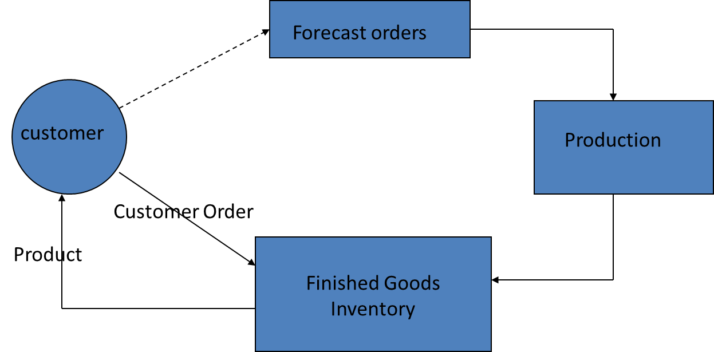
Making to stock means production without actual requirements. The Sales Order does not drive the production program but the forecast does. Incoming Sales Orders use existing inventory for the delivery which keeps the customer lead time to a minimum.

Slide 26
Make To Order (MTO)
This strategy still is for standard products which have a clearly defined specification. Other than MTS, there is absolutely no forecast on products which are made to an order from a customer. You start production after the customer’s request comes in and not, like with MTS, beforehand.
When you identify a product to be made to order, the availability check in the Sales Order needs a lead time; the time it takes to replenish or produce the product from soup to nuts. Therefore when a customer requests the item, no freely available stock to fulfill the order can be found. Everything is made from scratch and takes its time.

Slide 28
. Make To Assemble - MTA‘
A manufacturing production strategy where a company stocks the basic components of a product based on demand forecasts, but does not assemble them until the customer places an order. This allows for order customization. MTA production is basically a hybrid of two other major types of manufacturing production strategies: make to stock (MTS) and make to order (MTO)

